Slide 1
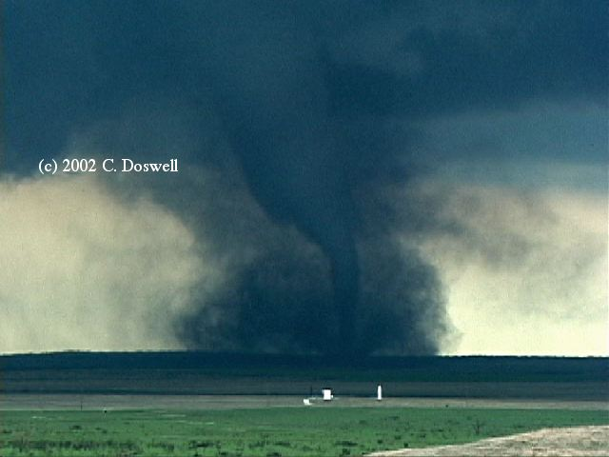
Satellite retrieved cloud microstructure providing insights and adds predictability to severe convective storms
Daniel Rosenfeld
The Hebrew University of Jerusalem, Israel

Slide 2
Outline
How can retrieved T-Re reveal cloud properties?
Aerosol-induced cloud invigoration and electrification.
Aerosol-induced severe storms
How can the retrieved T-Re be indicative of the storm severity?
satellite T-Re reveals aerosol impacts on intensity of tropical cyclones.

Slide 3
Outline
How can retrieved T-Re reveal cloud properties?
Aerosol-induced cloud invigoration and electrification.
Aerosol-induced severe storms
How can the retrieved T-Re be indicative of the storm severity?
satellite T-Re reveals aerosol impacts on intensity of tropical cyclones.

Slide 4

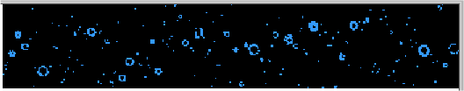

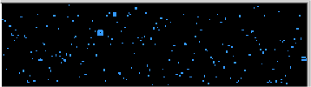

Height, m Temp, °C
7,073 m, -12.2 °C
6,793 m, -11.8 °C
6,124 m, -8.7 °C
5,816 m, -6.8 °C
4,406 m, +1.3 °C
Aircraft measured images of vertical development of cloud and rain drops in the cloud
4

Slide 5
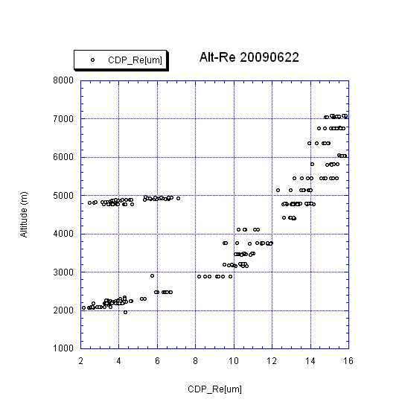
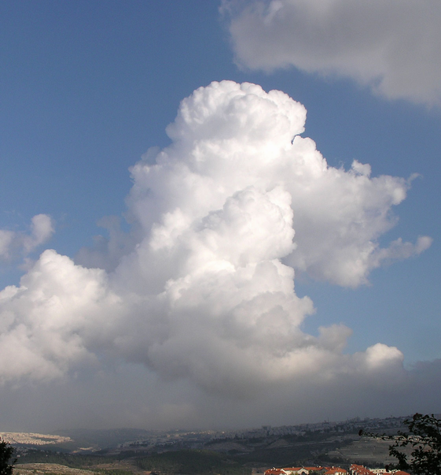

Rain develops in the updraft when Re reaches 14 μm.
Height for onset of rain
Hyderabad, India
22 June 2009
Re for onset of significant rain (> 1 mm/h)
No rain Rain
Cloud drop effective radius, r_{e} [μm]
5

Slide 6
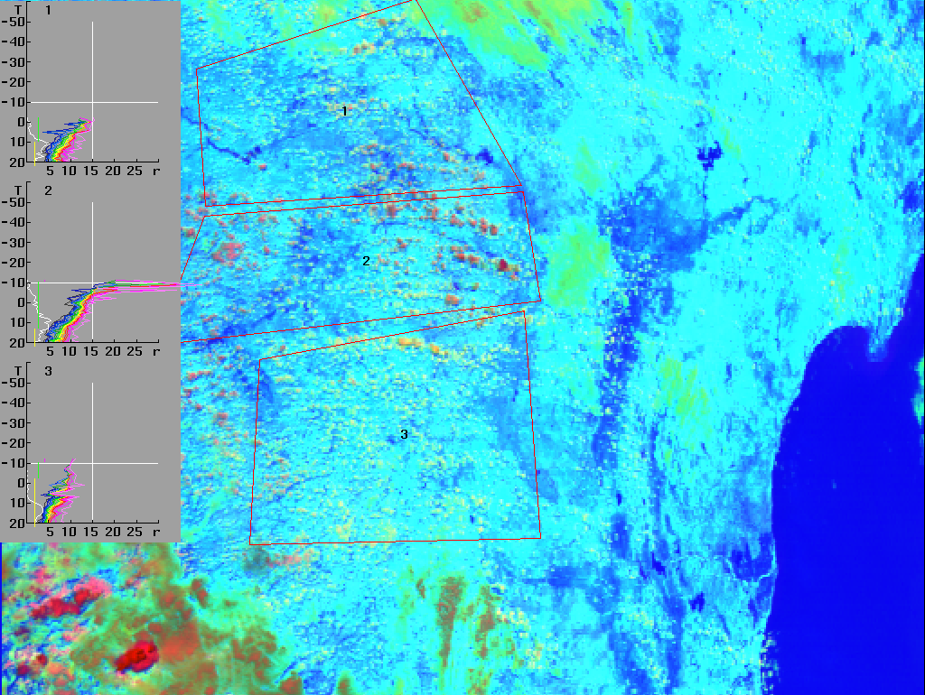
Red: Visible reflectance
Green: 3.7 μm reflectance
Blue: 11 μm temperature
Small Drops
Large Drops
-6.8ºC
No rain Rain
Cloud drop effective radius, r_{e} [μm]
6
MODIS AQUA 2009 06 22 08:30 UT

Slide 7
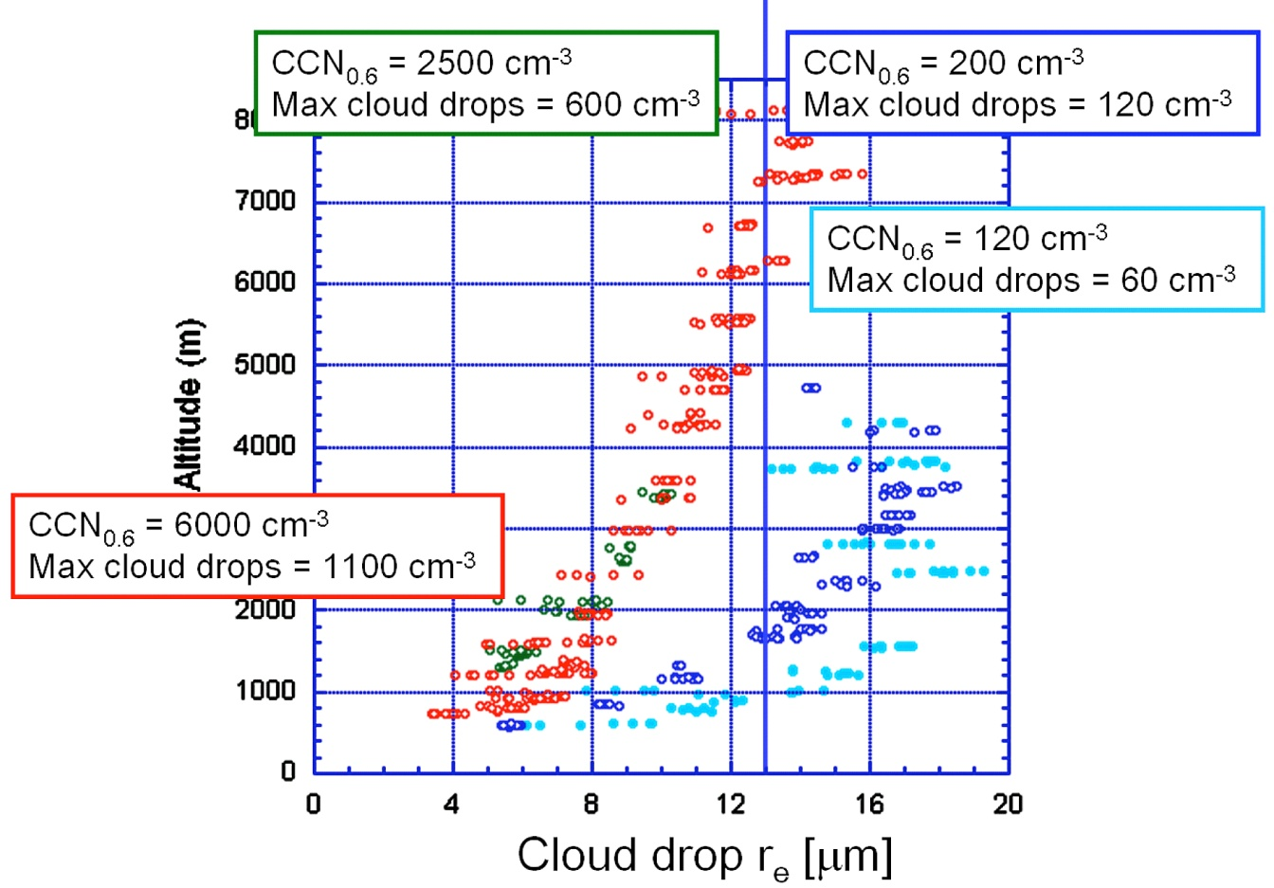
Rain initiates when cloud drop effective radius exceeds 14 μm.
The height for rain initiation increase linearly with cloud base drop concentration,
cloud base drop concentration increases with more aerosols and greater updrafts.
Freud E., and D. Rosenfeld, 2012: Linear relation between convective cloud drop number concentration and depth for rain initiation. J. Geophys. Res., in press.
Added aerosols can delay the initiation of rain to above the freezing level even in tropical clouds
Hyderabad 26.9.2010
Bay of Bengal
26.9.2010
Bay of Bengal
27.9.2010
Rosenfeld and Woodley, CAIPEEX-2 Final report to IITM.
Bareilly 23.9.2009
8
No Rain
Rain

Slide 8
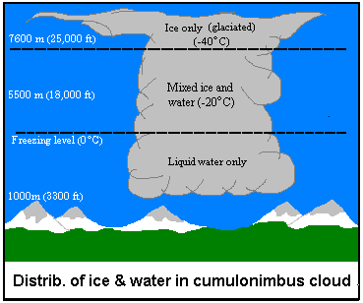

Slide 9
Hyderabad 26.9.2010
Bay of Bengal
26.9.2010
0ºC
Bay of Bengal
27.9.2010
Bareilly 23.9.2009
8
No Rain
Rain
The relation between r_{e} and depth cloud depth above its base (D) is uniquely related to CCN.
Rosenfeld and Woodley, CAIPEEX-2 Final report to IITM.

Slide 10







8130 m, -17.1ºC. Max LWC=0.49 gm⁻³.
Frozen drops, small graupel and crystals.
7700 m, -14.7ºC. Max LWC=1.45 gm⁻³. Small rain drops, large freezing rain drops and small graupel.
7350 m, -11.8ºC. Max HWLWC=0.87 gm⁻³.
Rain drops and large freezing rain drops.
6720 m, -8.1ºC. Max LWC=1.66 gm⁻³.
Supercooled rain drops
6270 m, -4.8ºC. Max LWC=1.05 gm⁻³.
Isolated supercooled rain drops
5530 m, -1.6ºC. Max LWC=2.91 gm⁻3.
No rain.
4700 m, +3.2ºC. Max LWC=2.45 gm⁻³.
No rain.

Slide 11
Outline
How can retrieved T-Re reveal cloud properties?
Aerosol-induced cloud invigoration and electrification.
Aerosol-induced severe storms
How can the retrieved T-Re be indicative of the storm severity?
satellite T-Re reveals aerosol impacts on intensity of tropical cyclones.

Slide 12
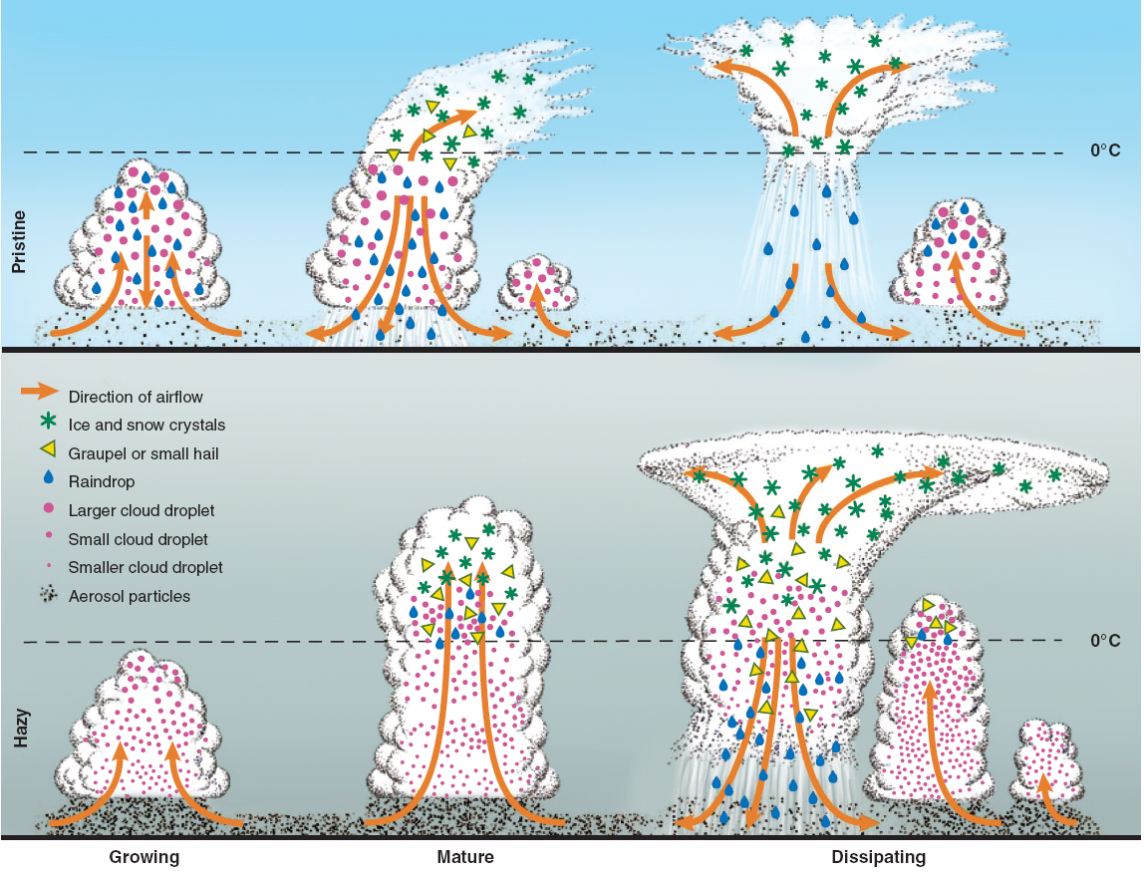

Rosenfeld et al., Science 2008
Growing Mature Dissipating
Hail

Slide 13
References
Aerosols Invigorate warm base convective clouds
Andreae, M. O., D. Rosenfeld, P. Artaxo, A. A. Costa, G. P. Frank, K. M. Longo, and M. A. F. Silva-Dias, 2004: Smoking rain clouds over the Amazon. Science, 303, 1337-1342.
Bell, T. L., D. Rosenfeld, K.-M. Kim, J.-M. Yoo, M.-I. Lee, and M. Hahnenberger, 2008: Midweek increase in U.S. summer rain and storm heights suggests air pollution invigorates rainstorms, J. Geophys. Res., 113, D02209, doi:10.1029/2007JD008623.
Fan, J., T. Yuan, J. M. Comstock, S. Ghan, A. Khain, L. R. Leung, Z. Li, V. J. Martins, and M. Ovchinnikov (2009), Dominant role by vertical wind shear in regulating aerosol effects on deep convective clouds, J. Geophys. Res., 114, D22206, doi:10.1029/2009JD012352.
Khain A., D. Rosenfeld and A. Pokrovsky, 2005: Aerosol impact on the dynamics and microphysics of convective clouds. The Quarterly Journal of the Royal Meteorological Societ, 131, 1-25.
Koren I., Y. J. Kaufman, D. Rosenfeld, L. A. Remer1, Y. Rudich, 2005: Aerosol invigoration and restructuring of Atlantic convective clouds. Geophys. Res. Lett., 32, L14828, doi:10.1029/2005GL023187.
Koren, I., J. V. Martins, L.A. Remer, H. Afargan (2008), Smoke invigoration versus inhibition of clouds over the Amazon. Science, 321, no. 5891, 946–949.
Lee, S. S., L. J. Donner, V. T. J. Phillips, and Y. Ming (2008b), The dependence of aerosol effects on clouds and precipitation on cloud system organization, shear and stability, J. Geophys. Res., 113, D16202, doi:10.1029/2007JD009224.
Rosenfeld D., U. Lohmann, G.B. Raga, C.D. O’Dowd, M. Kulmala, S. Fuzzi, A. Reissell, M.O. Andreae, 2008: Flood or Drought: How Do Aerosols Affect Precipitation? Science, 321, 1309-1313.

Slide 14
References
Aerosols enhance cloud electrification
Andreae M. O., D. Rosenfeld, P. Artaxo, A. A. Costa, G. P. Frank, K. M. Longo, and M. A. F. Silva-Dias, 2004: Smoking rain clouds over the Amazon. Science, 303, 1337-1342.
Bell, T. L., D. Rosenfeld, and K.-M. Kim, 2009: Weekly cycle of lightning: Evidence of storm invigoration by pollution. Geophys. Res. Lett., 36, L23805, doi:10.1029/2009GL040915.
Khain, A., N. Cohen, B. Lynn, and A. Pokrovsky, 2008a: Possible aerosol effects on lightning activity and structure of hurricanes. J. Atmos. Sci., 65, 3652–3667.
Williams, E., D. Rosenfeld, M. Madden et al., 2002: Contrasting convective regimes over the Amazon: Implications for cloud electrification. J. Geophys. Res., 107 (D20), 8082, doi:10.1029/2001JD000380.Andreae,
Yuan, T., L. A. Remer, K. E. Pickering, and H. Yu (2011), Observational evidence of aerosol enhancement of lightning activity and convective invigoration. Geophys. Res. Lett., 38, L04701, doi:10.1029/2010GL046052.

Slide 15
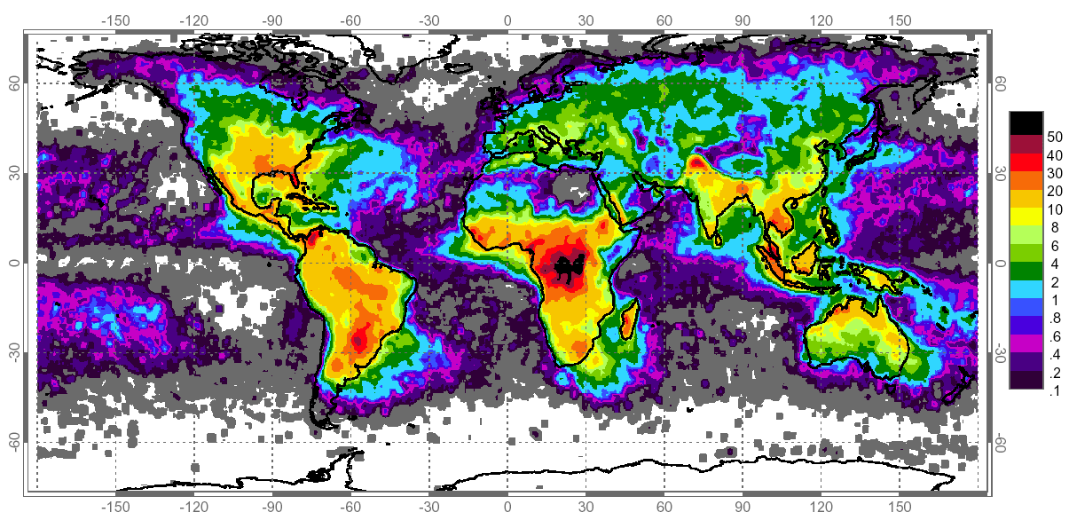
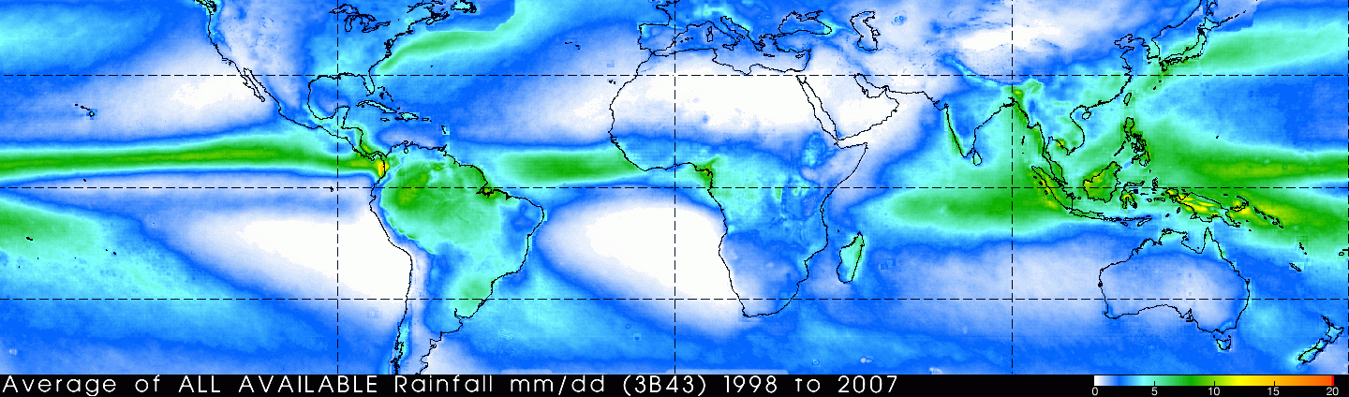
Annual average lightning density [flashes km⁻²]
Why is Continental - Maritime classification so fundamental?
TRMM annual average rainfall amount [mm / day]
There is little relation between lightning and rainfall amount

Slide 16
Climatological annual means of simulated accumulation mode aerosol particle concentration obtained from a 10-year integration. The geographical distribution of the lowermost model layer (upper panel), which is about 60 m thick, and the zonally averaged vertical cross section (lower panel) are shown. The concentrations are given at STP conditions (from Lauer and Hendricks, 2006).

Slide 17
Do lightning abound over land due to:
suppression of warm rain?
and/or greater sensible heat fluxes?
Are there less lightning over ocean due to sea salt giant CCN that promote warm rain?

Slide 18
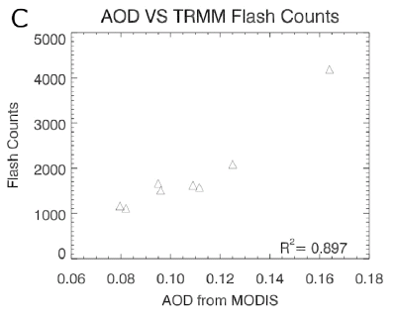
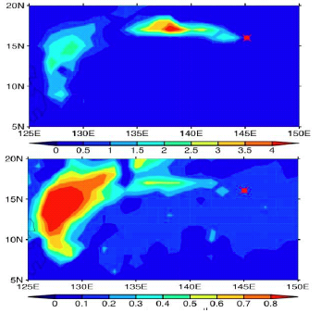
Map of the Western Pacific
Volcanic summer
Volcano
Flash Counts
Non Volcanic summers
SO₂
Volcano
AOD from MODIS
AOD
Lightning flashes over ocean more than doubled in a volcanic plume to the east of the Philippines.
Yuan T., L. A. Remer, K. E. Pickering, and H. Yu, 2011: Observational evidence of aerosol enhancement of lightning activity and convective invigoration. GRL, 38, L04701.

Slide 19

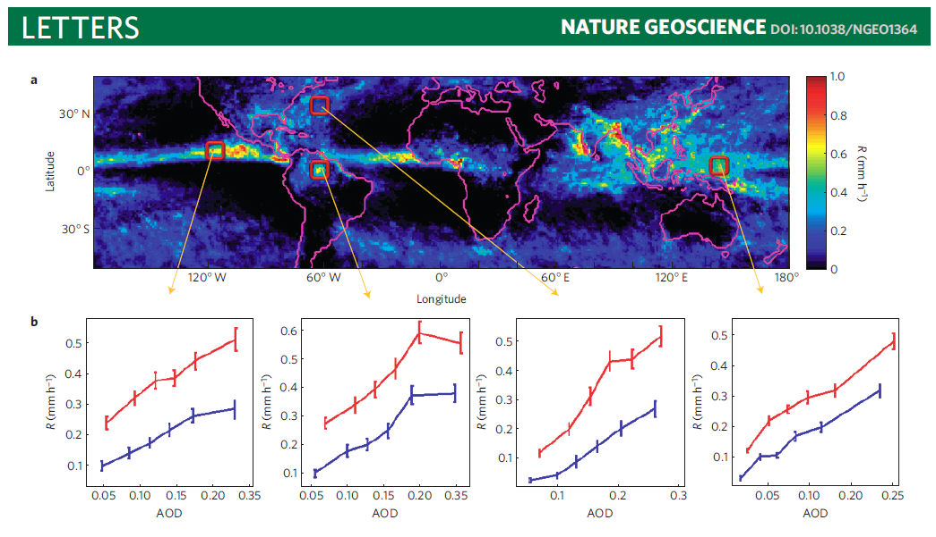
Koren et al., 2012
Excluding 0
TRMM Rain Rate (mm/hr)
Including 0
MODIS Aerosol Optical Depth
Stronger TRMM rain intensity is observed with greater AOD
Radar & PMW R is dominated by the hydrometeor sizes

Slide 20
Outline
How can retrieved T-Re reveal cloud properties?
Aerosol-induced cloud invigoration and electrification.
Aerosol-induced severe storms
How can the retrieved T-Re be indicative of the storm severity?
satellite T-Re reveals aerosol impacts on intensity of tropical cyclones.

Slide 21







Conceptual model for aerosol effects on hydrometeors
Updraft invigoration
No updraft invigoration
-40ºC
0ºC
10ºC
Low
CCN
High
CCN
20ºC
Drop size > warm rain threshold
Low
CCN
High
CCN
Drop size = warm rain threshold
Drop size < warm rain threshold

Slide 22
References
Causes larger hydrometeors and hail
Andreae, M. O., D. Rosenfeld, P. Artaxo, A. A. Costa, G. P. Frank, K. M. Longo, and M. A. F. Silva-Dias, 2004: Smoking rain clouds over the Amazon. Science, 303, 1337-1342.
Khain A. P., D. Rosenfeld and A. Pokrovsky, 2001: Simulating convective clouds with sustained supercooled liquid water down to -37.5°C using a spectral microphysics model. Geophysical Research Letters, 28, 3887-3890.
Khain A., D. Rosenfeld and A. Pokrovsky, 2005: Aerosol impact on the dynamics and microphysics of convective clouds. The Quarterly Journal of the Royal Meteorological Societ, 131, 1-25.
Khain, A., D. Rosenfeld, A. Pokrovsky, U. Blahak and A. Ryzhkov, 2011: The role of CCN in precipitation and hail in a mid-latitude storm as seen in simulations using a spectral (bin) microphysics model in a 2D dynamic frame. Atmos. Res. 99, 129-146.
Rosenfeld D. and I. M. Lensky, 1998: Satellite-based insights into precipitation formation processes in continental and maritime convective clouds. The Bulletin of American Meteorological Society, 79, 2457-2476.
Rosenfeld D. and C. W. Ulbrich, 2003: Cloud microphysical properties, processes, and rainfall estimation opportunities. Chapter 10 of " Radar and Atmospheric Science: A Collection of Essays in Honor of David Atlas". Edited by Roger M. Wakimoto and Ramesh Srivastava. Meteorological Monographs 52, 237-258, AMS.
Wang, J., S. C. van den Heever, J. S. Reid (2009), A conceptual model for the link between Central American biomass burning aerosols and severe weather over the south central United States. Environ. Res. Lett. 4, 015003, doi: 10.1088/1748-9326/4/1/015003.

Slide 23


Not Polluted.
Small Hail that melts to rain with more surface area that evaporates more strongly and causes more cooling. This causes stronger downdrafts that spread on the surface and undercut the updraft and outruns the storm, thereby disrupting the organization of the tornado.

Slide 24
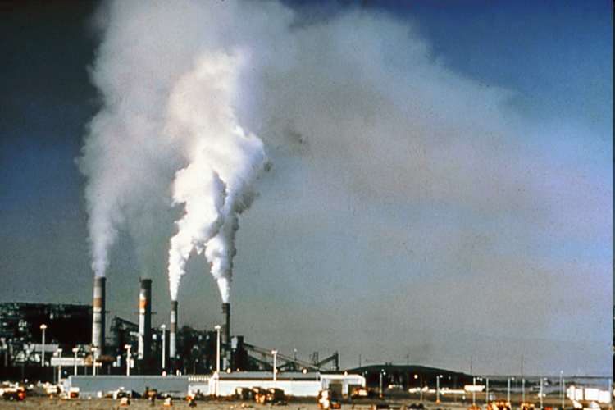
Polluted.
Large Hail and rain drops.
Less evaporation and weaker cooling.
Weaker downdrafts.

Slide 25
References
Aerosols enhance risk for tornadoes
Lerach, D. G., B. J. Gaudet, and W. R. Cotton (2008), Idealized simulations of aerosol influences on tornadogenesis, Geophys. Res. Lett., 35, L23806, doi:10.1029/2008GL035617.
Rosenfeld, D., W. L. Woodley, A. Lerner, G. Kelman, and D. T. Lindsey (2008), Satellite detection of severe convective storms by their retrieved vertical profiles of cloud particle effective radius and thermodynamic phase, J. Geophys. Res., 113, D04208, doi:10.1029/2007JD008600.
Rosenfeld D., T.L. Bell, 2011: Why do tornados and hailstorms rest on weekends? Journal of Geophysical Research, Early online release.
Snook, N., M. Xue (2008), Effects of microphysical drop size distribution on tornadogenesis in supercell thunderstorms. Geophys. Res. Lett., 35, L24803, doi:10.1029/2008GL035866.
van den Heever, S. C., and W. R. Cotton (2004), The impact of hail size on simulated supercell storms, J. Atmos. Sci., 61, 1596–1609.

Slide 26
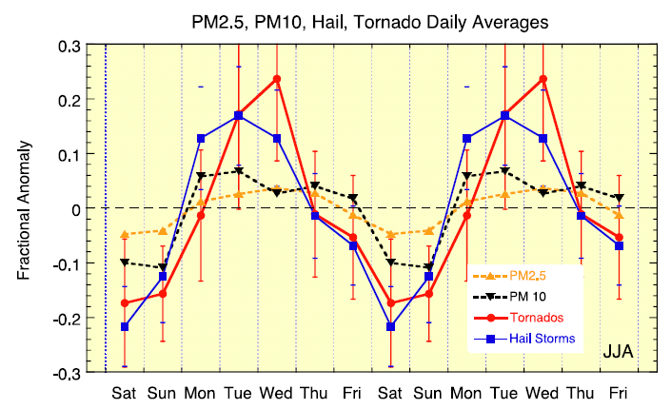
Weekly cycle of aerosols, hail and tornadoes over the USA during JJA to the east of 100W.
Rosenfeld, D., and T. L. Bell (2011), Why do tornados and hailstorms rest on weekends?, J. Geophys. Res., 116, D20211, doi:10.1029/2011JD016214.

Slide 27
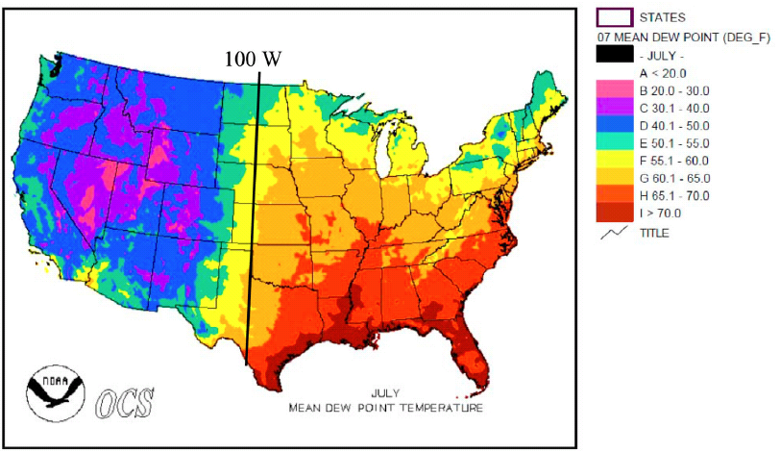
July mean surface dew point
Summer due points are high to the east of 100W, therefore we expect there during JJA the stronger aerosol-induced enhancement of lightning, hail and tornados.
We expect much less in the west and during non-summer.

Slide 28
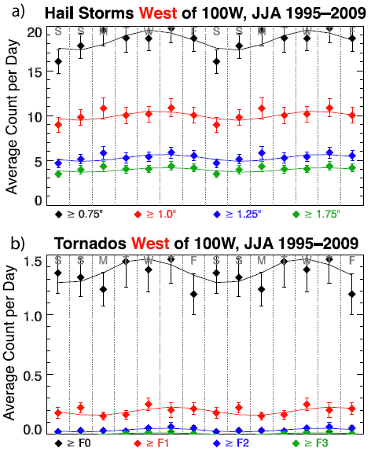
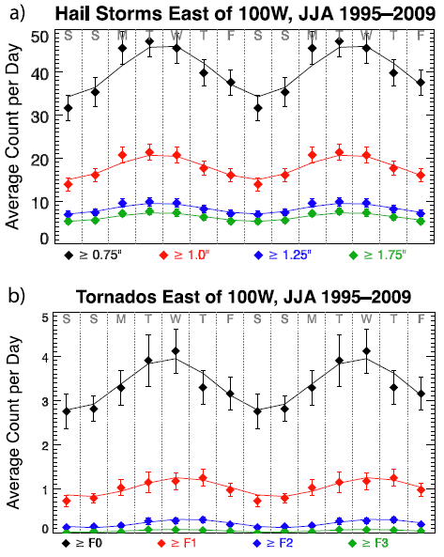

Slide 29
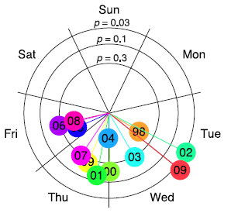
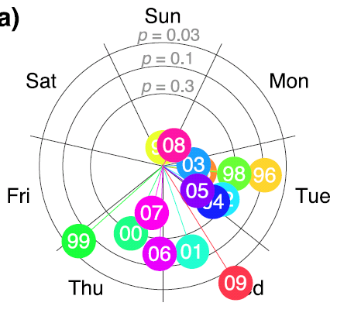

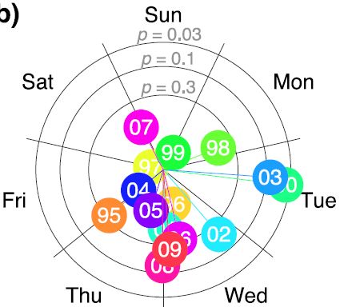
Lightning
Hail
Tornado
JJA, Afternoon, USA, east of 100W

Slide 30
Outline Questions
How the cloud microstructure can be indicative of the storm severity ?
How can the satellite retrieve this microstructure ?

Slide 31
Outline
How can retrieved T-Re reveal cloud properties?
Aerosol-induced cloud invigoration and electrification.
Aerosol-induced severe storms
How can the retrieved T-Re be indicative of the storm severity?
satellite T-Re reveals aerosol impacts on intensity of tropical cyclones.

Slide 32
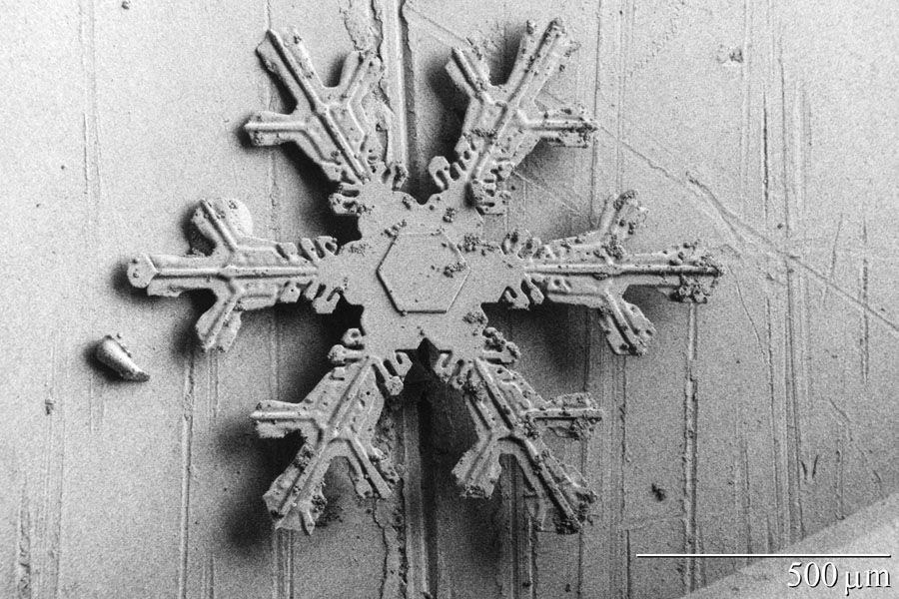

Slide 33
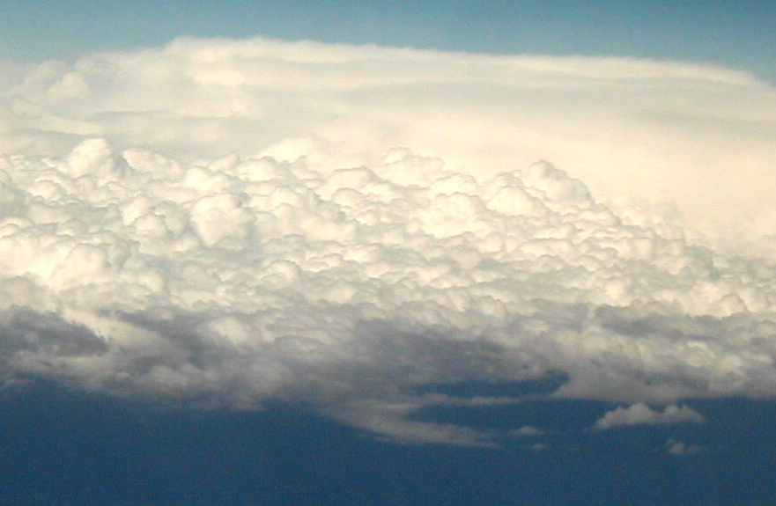
Satellite measurements of
glaciation temperature, Tg
Ice, glaciated
Mixed phase
Cloud top temperature, °C
Water
Cloud particle effective radius, μm

Slide 34

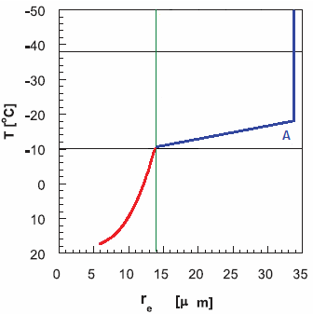
Methodology
Cont, Weak updraft
0°C
Updraft
Cloud droplets
Rain drop
Ice precipitation
Ice crystal
After: Rosenfeld et al. 2008

Slide 35

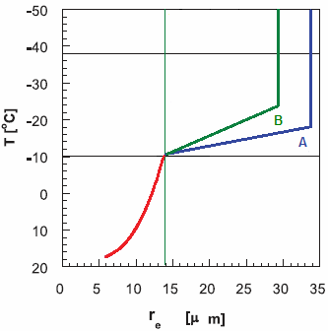
Methodology
Cont, Moderate updraft
0°C
Updraft
Cloud droplets
Rain drop
Ice precipitation
Ice crystal
After: Rosenfeld et al. 2008

Slide 36

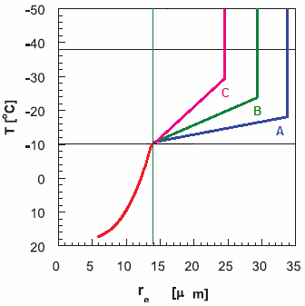
Methodology
Cont, Strong updraft
0°C
Updraft
Cloud droplets
Rain drop
Ice precipitation
Ice crystal
After: Rosenfeld et al. 2008

Slide 37

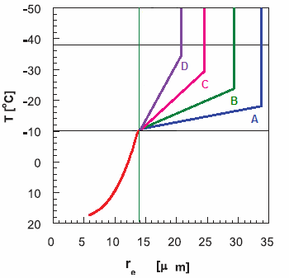
Methodology
Cont, Severe updraft
0°C
Updraft
Cloud droplets
Rain drop
Ice precipitation
Ice crystal
After: Rosenfeld et al. 2008

Slide 38

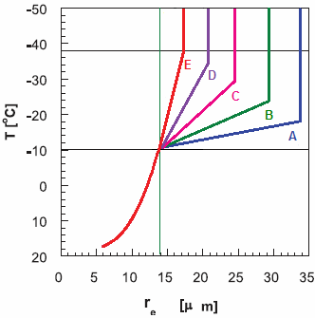
Methodology
Cont, Extreme updraft
0°C
Updraft
Cloud droplets
Rain drop
Ice precipitation
Ice crystal
After: Rosenfeld et al. 2008

Slide 39

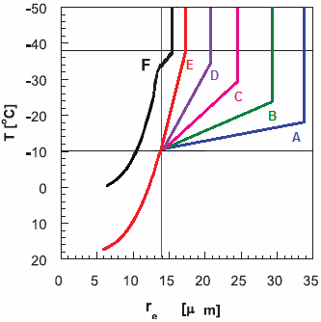
Methodology
Cont, Cold base, Strong updraft
0°C
Updraft
Cloud droplets
Rain drop
Ice precipitation
Ice crystal
After: Rosenfeld et al. 2008

Slide 40

How the cloud microstructure can be indicative of the storm severity ?
How can satellite retrieve this microstructure ?
T
?
?
Effective radius
After: Rosenfeld and Lensky 1998

Slide 41
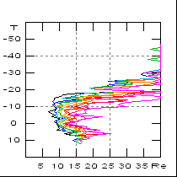
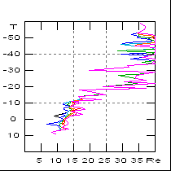
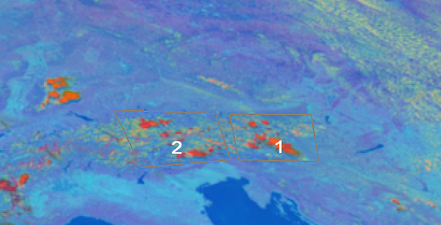
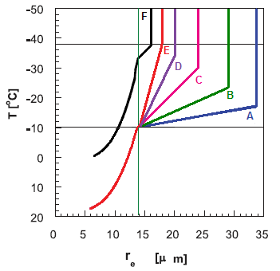
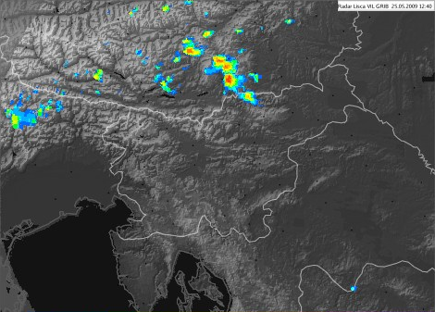

12:42 UTC
25 May 2009
Early convection at mid-day
© ARSO
VIL
Kg/m^2

Slide 42
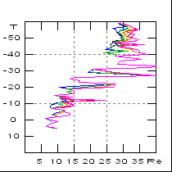
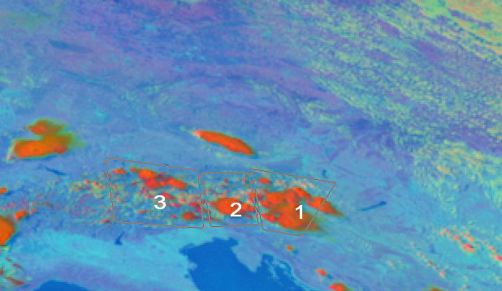
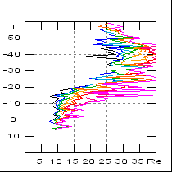
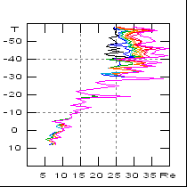
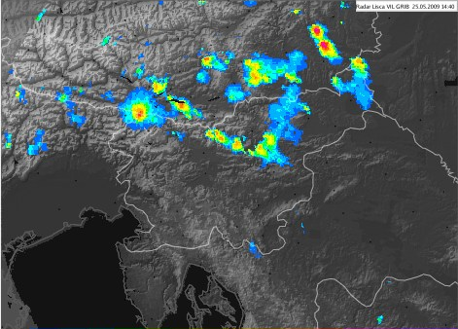
14:42 UTC
25 May 2009
Homogenous microphysical zones
© ARSO
© ARSO
VIL
Kg/m^2
Kg/m^2

Slide 43
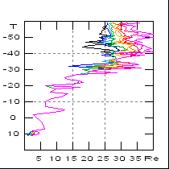
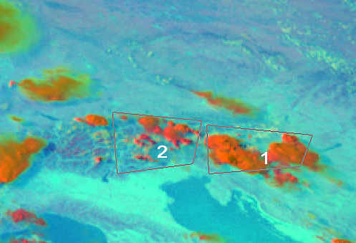
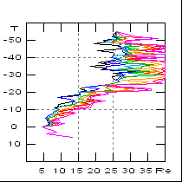
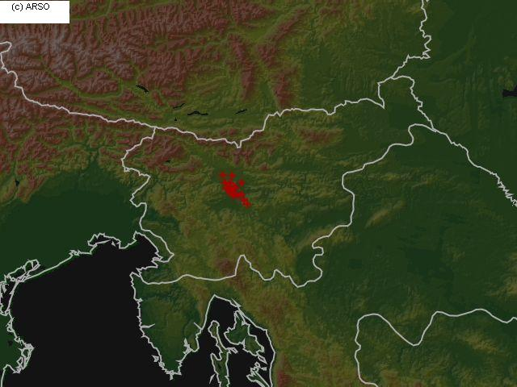
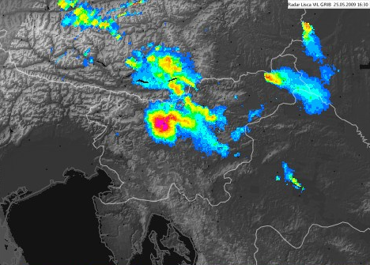
16:27 UTC
25 May 2009
Significant difference of the profiles
2
1
Large hail
(6-7 cm diameter)
16:30-17:00 UTC
(Reports from ESSL)
ground hail reports
ground hail reports
© ARSO
© ARSO
VIL
Kg/m^2
Kg/m^2
Kg/m²

Slide 44
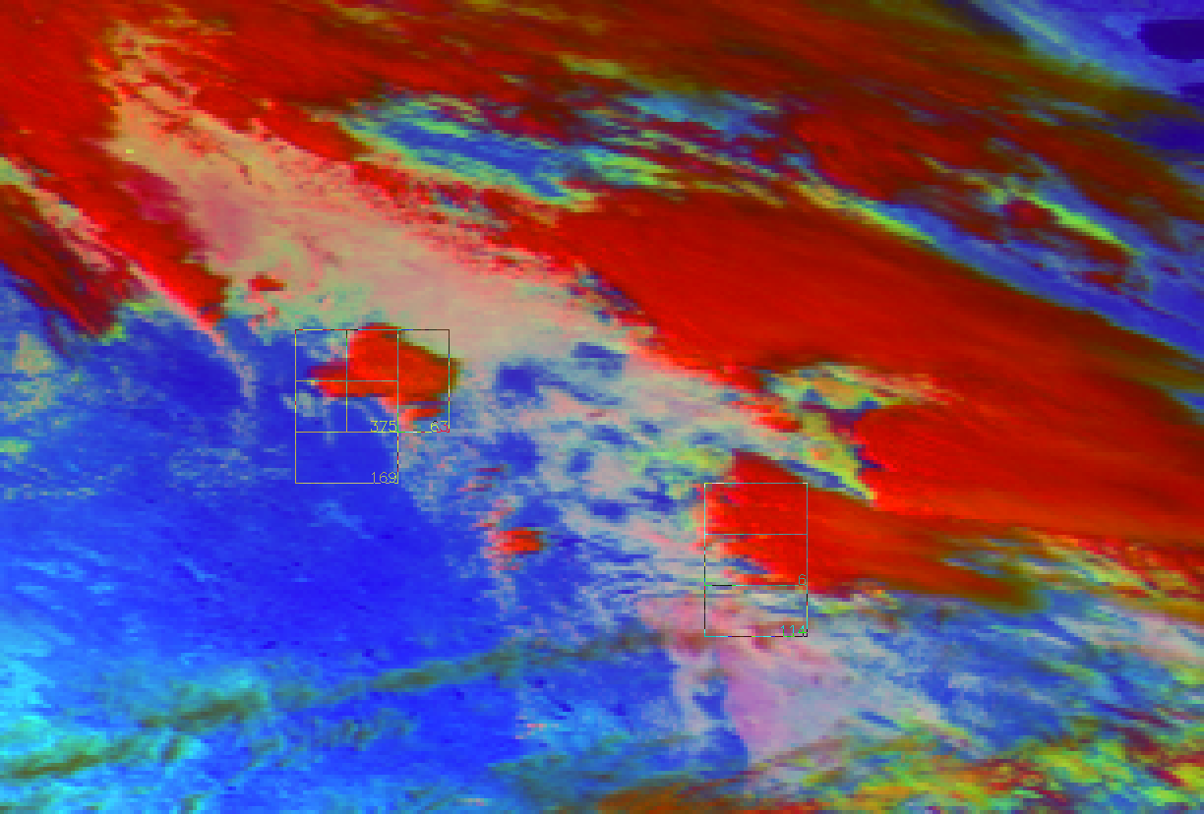
Automated identification
G-11 2008 05 10 21:00

Slide 45
Outline
How can retrieved T-Re reveal cloud properties?
Aerosol-induced cloud invigoration and electrification.
Aerosol-induced severe storms
How can the retrieved T-Re be indicative of the storm severity?
satellite T-Re reveals aerosol impacts on intensity of tropical cyclones.

Slide 46
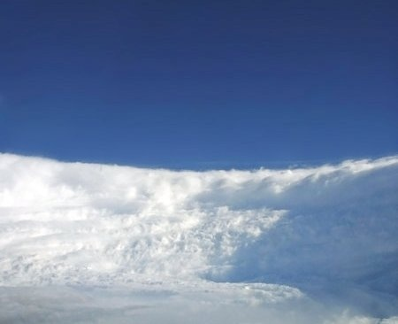

Aerosol effects on Microstructure and Intensity of Tropical Cyclones
Daniel Rosenfeld, William L. Woodley, Alexander Khain, William R. Cotton, Gustavo Carrió , Isaac Ginis and Joseph H. Golden
BAMS 2012, Accepted.
Thanks to funding by the US Department of Homeland Security

Slide 47


Original air flow
Original cloud
Heavy sea spray
0°C
20-50 km
200-300 km

Slide 48
Original cloud
Heavy sea spray
Disturbed air flow
Cooled cloud
Cooled Air
Disturbed Lightning
Warmed cloud
Polluted Air
0°C
20-50 km
200-300 km

Slide 49
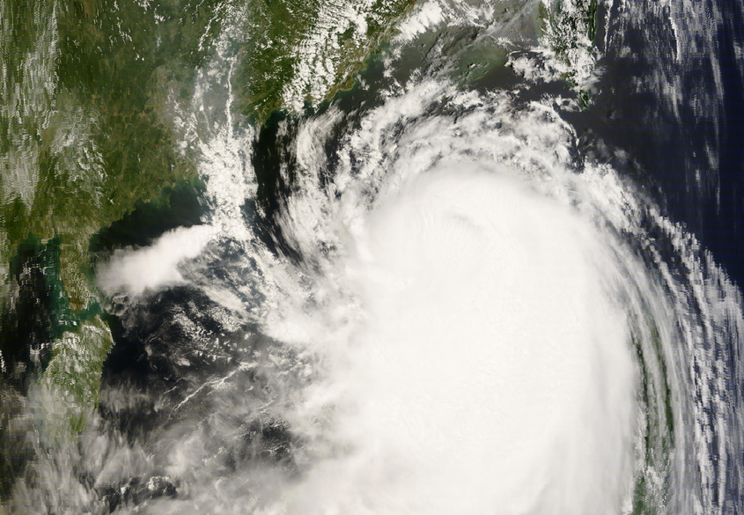
Typhoon Nuri
MODIS TERRA 21 Aug 2008 03:00 UT
Rosenfeld et al., submitted to BAMS, 2011

Slide 50
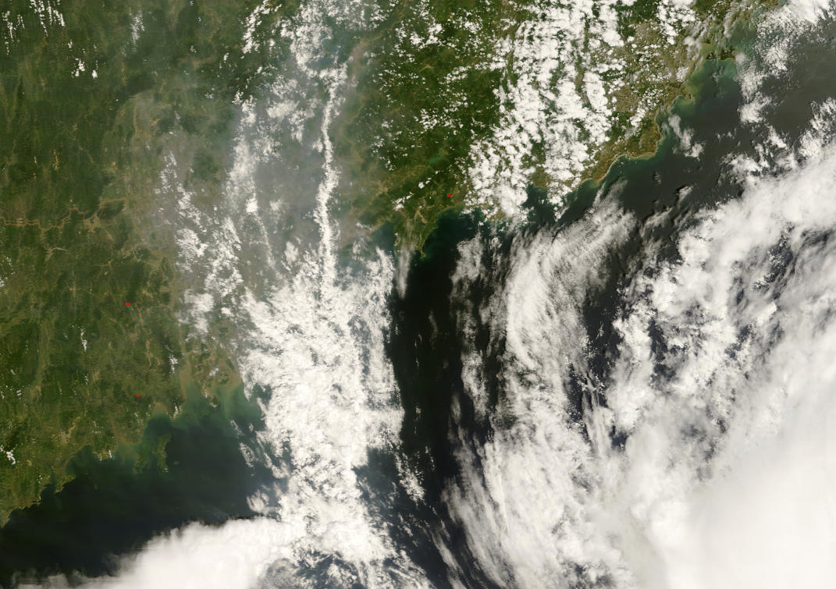
MODIS TERRA 21 Aug 2008 03:00 UT
Rosenfeld et al., submitted to BAMS, 2011

Slide 51
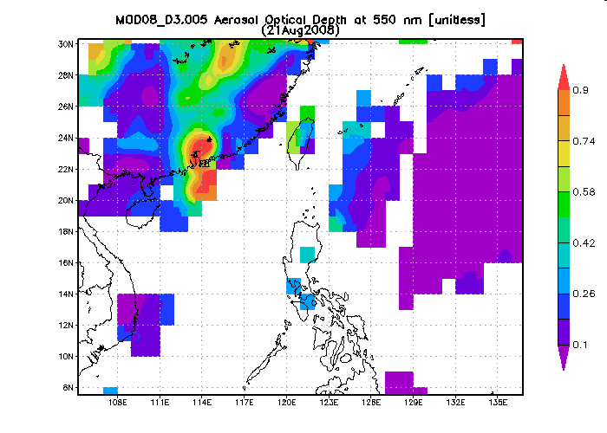


A
8
7
4
5
1
2
6
3
B
AOD
A
B
Rosenfeld et al., submitted to BAMS, 2011
Notes:
51

Slide 52
Typhoon Nuri
MODIS TERRA 21 Aug 2008 03:00 UT
Rosenfeld et al., submitted to BAMS, 2011

Slide 53


2
1
Rosenfeld et al., submitted to BAMS, 2011

Slide 54
2
1
Rosenfeld et al., submitted to BAMS, 2011

Slide 55






TRMM 21 Aug 2008 07:16 UT
A
C
D
A
D
F
F
E
B
B
A
B
C
D
E
F
Rosenfeld et al., submitted to BAMS, 2011
Notes:
55
55

Slide 56
References
Weaken tropical cyclones
Carrió, G. G., and W. R. Cotton, 2011: Investigations of aerosol impacts on hurricanes: Virtual seeding flights. Atmos. Chem. Phys., 11, 2557–2567.
Cotton, W.R., H. Zhang, G.M. McFarquhar, and S.M. Saleeby, 2007: Should we consider polluting hurricanes to reduce their intensity? J. Wea. Mod., 39, 70-73.
Dunion, J. P., and C. S. Velden, 2004: The impact of the Saharan Air Layer on Atlantic tropical cyclone activity. Bull. Amer. Meteorol. Soc., 85, 353– 365.
Jenkins, G. S., A. S. Pratt, and A. Heymsfield, 2008: Possible linkages between Saharan dust and tropical cyclone rain band invigoration in the eastern Atlantic during NAMMA-06. Geophys. Res. Lett., 35, L08815, 7 pp. doi:10.1029/2008GL034072.
Khain, A., N. Cohen, B. Lynn, and A. Pokrovsky, 2008a: Possible aerosol effects on lightning activity and structure of hurricanes. J. Atmos. Sci., 65, 3652–3667.
Khain A., B. Lynn, and. J. Dudhia, 2010: Aerosol Effects on Intensity of Landfalling Hurricanes as Seen from Simulations with the WRF Model with Spectral Bin Microphysics. J. Atmos. Sci., 67, 365–384.
Khain A., and B. Lynn, 2011: Simulation of Tropical Cyclones Using a Mesoscale Model with Spectral Bin Microphysics, In: Recent Hurricane Research- Climate, Dynamics, and Societal Impacts, Anthony R. Lupo, pp. 197-227, Intech Open Access Publisher Rijeka
Rosenfeld D., A. Khain, B. Lynn, W.L. Woodley, 2007: Simulation of hurricane response to suppression of warm rain by sub-micron aerosols. Atmos. Chem. Phys., 7, 3411-3424.
Rosenfeld D., M. Clavner and R. Nirel, 2011: Pollution and dust aerosols modulating tropical cyclones intensities. Atmospheric Research (June 2011) doi:10.1016/ j.atmosres.2011.06.006.
Zhang, H., G.M. McFarquhar, S.M. Saleeby, and W.R.Cotton 2007: Impacts of Saharan dust as CCN on the evolution of an idealized tropical cyclone. Geophys. Res. Lett. 34 L14812, doi: 10.2029/2007GL029876

Slide 57
Summary
Aerosols, by creating larger numbers of smaller cloud drops in deep convection:
Convert warm rain to mixed phase
Enhance cloud electrification
Invigorate warm base convective clouds
Causes larger hydrometeors and hail
Enhance risk for tornadoes
Weaken tropical cyclones

