Slide 1
Rainfall Detection through COMS in KMA
Sung-Rae Chung
KMA/NMSC
2012 Convection Working Group Meeting (March 27-30, 2012, Prague, Czech Republic)

Slide 2
COMS Rainfall Intensity (RI) Convective + Stratiform
COMS RI is estimated using relationship between COMS IR1 (10.8μm) brightness temperature and SSM/I rain rate.
RI: Rain Rate of SSM/I
T*_{10.8}: Brightness Temperature of IR1
a, b: regression coefficients
Cloud detection
Previous 36hrs SSM/I Rain rate
Cloudy
NO
YES
Calculate RI
Static | Matching Dataset | Dynamic
Cirrus screening using Tb12
RI Screening
(0.5 <RI < 35 mm/hr)
RI Look-Up Table
Validation
AWS, SSM/I or TRMM
SSM/I: Special Sensor Microwave/Imager
DMSP: Defense Meteorological Satellite Program
AWS: Automatic Weather System

Slide 3
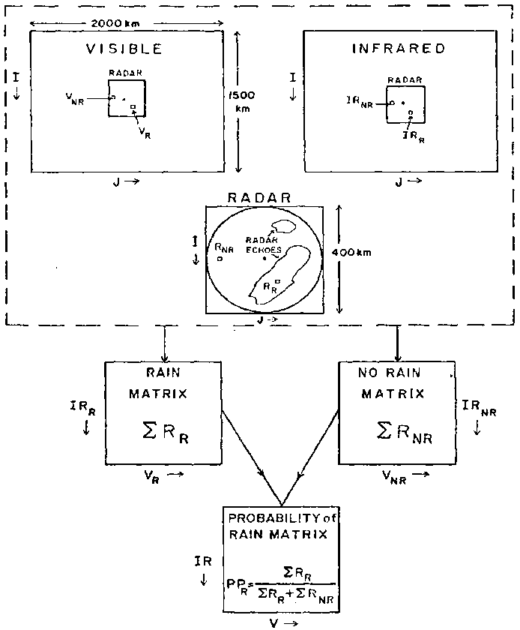
KMA CRR Calibration Matrices
COMS data
IR_{10.8}, WV_{6.7}, VIS_{0.68}
KMA Radar data
CMAX and Rainfall rate from CAPPI
Solar Zenith Angle
< 85º
NO
YES
2D CM
IR_{10.8}
IR_{10.8}-WV_{6.7}
3D CM
IR_{10.8}
IR_{10.8}-WV_{6.7}
VIS_{0.68}
Rain Probability Matrices
NRR, NNR, TRR, MXM
Average Rainfall rate Matrices
Maximum Rainfall rate Matrices
NRR: Number of Radar Rainy pixels
NNR: Number of Radar No-rainy pixels
TRR: Total accumulation Radar Rainfall rate
MXM: Maximum rain rate
RPM: Rain Probability Matrices
CRR Calibration Matrices

Slide 4
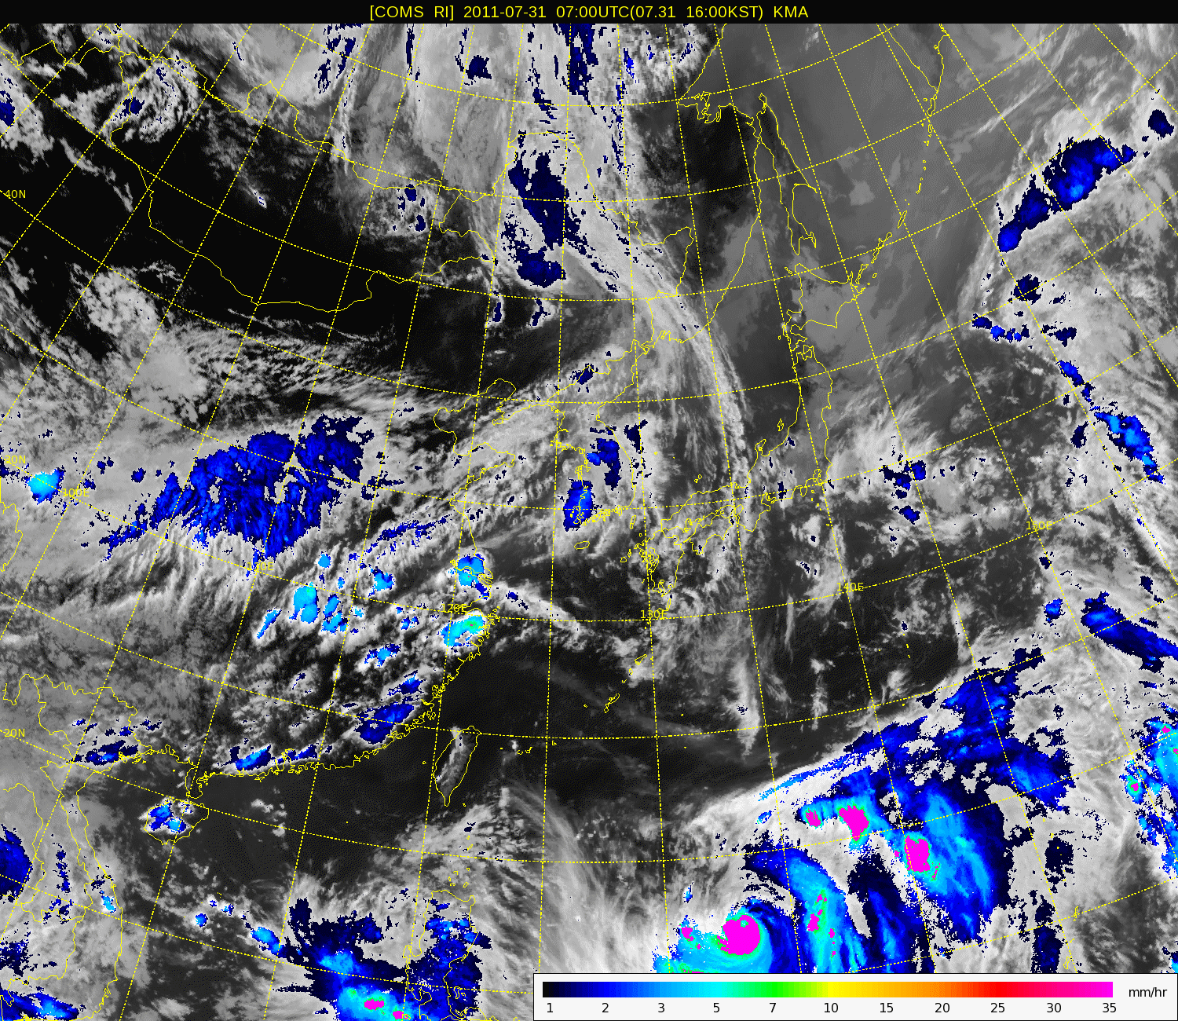
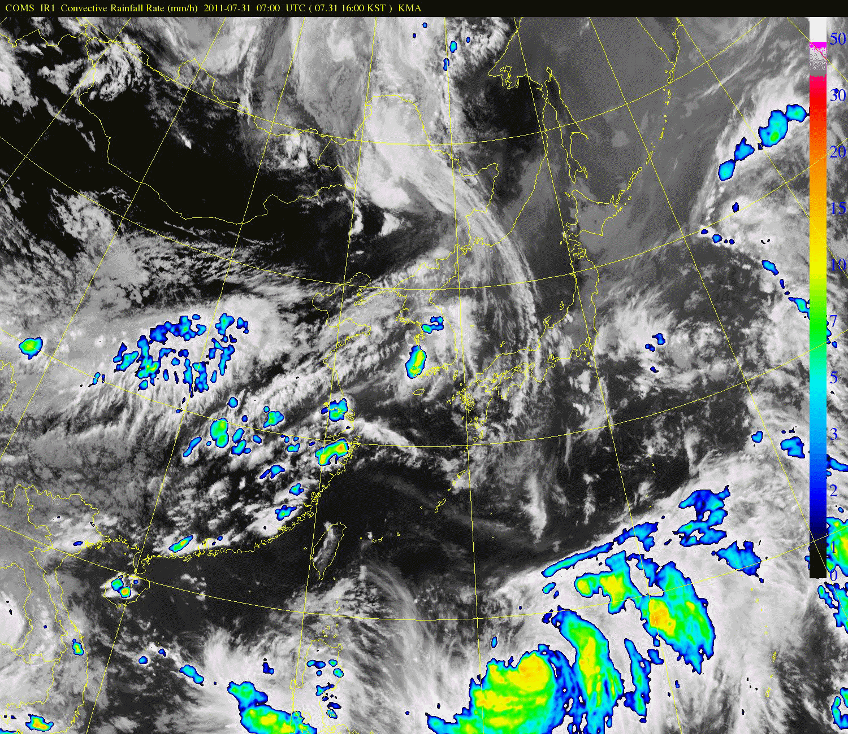
2011. 07. 31 0700 UTC ~ 08. 01 0300 UTC
RI
CRR
*CM of CRR is original. Typhoon MUIFA

Slide 5
AWS 강우자료 및 위성관측 강우의 일변화 연구
Korea vs. US (Courtesy Sohn et al.(SNU))
Korea
US
(Oklahoma)
TRMM TMI
85V GHz TB
TRMM PR
reflectivity, CTH, rain rate
Collocated data
CTH (cloud top height), TB85V
vertical dist. reflectivity, RR
JJA 2003-2006

Slide 6
PDF classified by PR rain rate
(Courtesy Sohn et al.(SNU))
Storm height (TRMM PR )
TMI TB85V

Slide 7
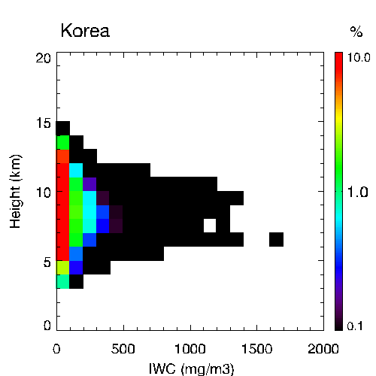
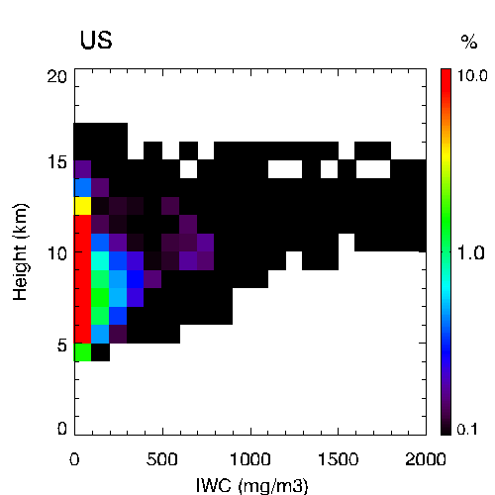
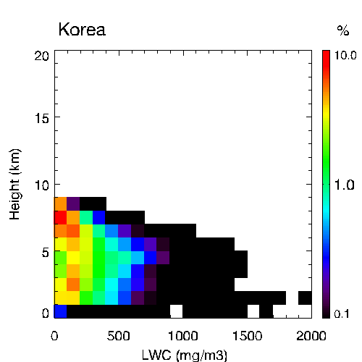
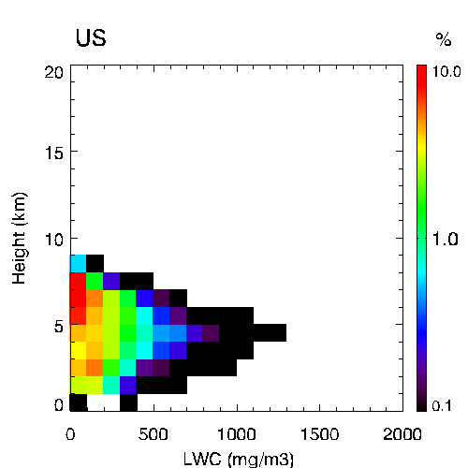
Frequency distributions of IWC and LWC
(Courtesy Sohn et al. (SNU))
# 91,939
ice
# 31,634
ice
Height (km)
Height (km)
CloudSat
IWC (mg/m³)
IWC (mg/m³)
# 46,678
water
# 12,766
water
Height (km)
JJA 2007~2010
LWC (mg/m³)
LWC (mg/m³)

Slide 8
Conclusions
(Courtesy Sohn et al. (SNU))
Characteristics of rainfall mechanism over Korea
Rainfall cloud height in summer season is relatively lower than US-OK
Small amount of ice crystal
Heavy rainfall can be occurred from not tall warm clouds
Expected Problems
- Satellite-based rain retrieval algorithm developed for US hardly
works over Korea.
- IR-based rainfall intensity over Korea loses the physical
background because of warmer rain clouds.

Slide 9
Thank You !

